Slide 1




InnovatorsHub
S.No
Name
Phone Number
Email ID
Role
1
Gaurav Ghanshyam Narkhede
7350885289
gaurav.narkhede@mitwpu.edu.in
Faculty
2
Krishnaraj Thadesar
9834312135
Kpt.Krishnaraj@gmail.com
Student
3
Harshit s soni
7666303439
harshit24337@gmail.com
Student
4
Parth Zarekar
8796180288
parthzarekar@gmail.com
Student
5
Shivani Swaraj
9099672174
88shivaniswaraj@gmail.com
Student
6
Tanmay Panday
8237879806
tanmay404103@outlook.com
Student
7
Kushal Shah
9890829250
kushalshah0403@gmail.com
Student
Division:
TY ECE VLSI
TEAM NAME
School of Electronic and Communication Engineering
School:

Slide 2
Smart Home Automation System
Joining Hands with Technology

Slide 3
ABOUT YOUR IDEA
Explain in 2 lines
Overview Of Your Idea
Problem Statement
Need Statement
To create a system that can automate any house or Facility, by providing complete remote control via a Mobile App, and to use AI to monitor and learn routines.
Creating an Easy to Install, Low Cost and Highly modifiable Home Automation System.
Make a system that users can easily install, use and monitor, while also implementing AI based learning to target and help differently Abled users.

Slide 4
Existing Solutions
Companies like Schnider Electric and Viki Knows provide solutions for Home Automation but their prices range from 50k to 4 Lacs, with limited Control over the applicances.
Solution
Our solution is to create a system that uses comparatively less materials, but making the code and Logical Process more Efficient, Both of which will help greatly in providing the same solutions, but in lesser cost.

Slide 5
USP
Cost of our product will be approximately Half of the market value, Solutions provided by Major Coorporations range to a Few Lacs which we will bring into the thousands.
Impact
The Impact of this product varies from Day to day ease of use to Life Saving Capabilities. It could be a life changer for the differently Abled population, and the Elder population Living alone. Our AI Will monitor their routines, and any abrupt changes could be alerted to loved ones immediately.

Slide 6
Commercialization
Mass Production of this product is easily Possible. The Circuit Boards would be Printed, and the components assembled and Sealed by Hand, and the User can easily Order this finished product online, while an electrician could install it instantly.
5 Year Plan
We intend to assemble the product by hand for the first Year
By the Second Year, Efficiency of the Product will improve as we will cut down the Microprocessors used to only use their relevant circuitry.
By the Third Year we will have designed and implemented well Trained and Modelled AI into these Products
This AI could be installed into pre-existing Products by simple Software Updates.
By the 5th Year we intend to completely automate production and thereby increase efficiency.

Slide 7

Overall system Block Diagram
Hall Module
Kitchen
Module
Control unit
(using raspberry pi 4)
Bedroom module
Smart System
Module
Mobile
App

Slide 8
Working

Slide 9
Overall system
Hall Module
Kitchen
Module
Control unit
(using raspberry pi 4)
Bedroom module
Smart System
Module
Mobile
App

Slide 10
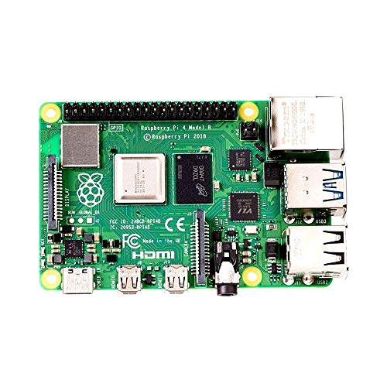
Control Unit
It is use for Hardware and software interface between system and user
It is a main controller of the project

Slide 11

Communication Tech

Slide 12
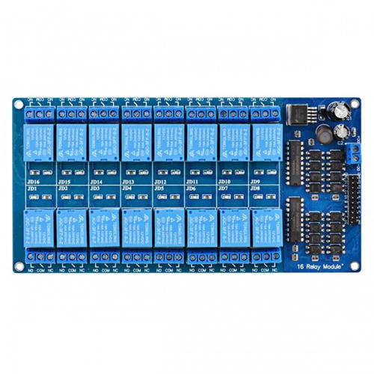
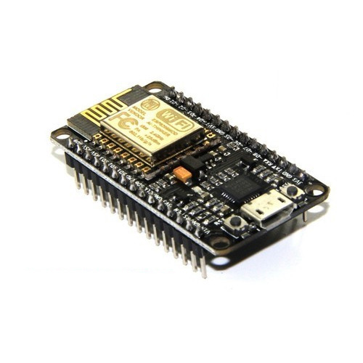
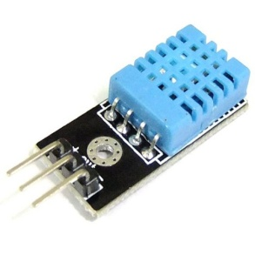
Hall Module
Hall appliances
Control Unit
Relay module

Slide 13
Kitchen Module
Control Unit
Kitchen appliances
Relay module

Slide 14
Bedroom module
Control Unit
bedroom appliances
Relay module

Slide 15
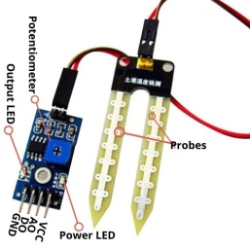
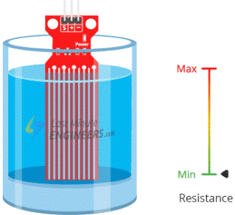
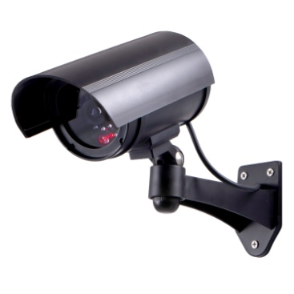
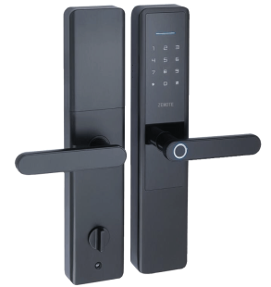
Smart System module
Control Unit

Slide 16
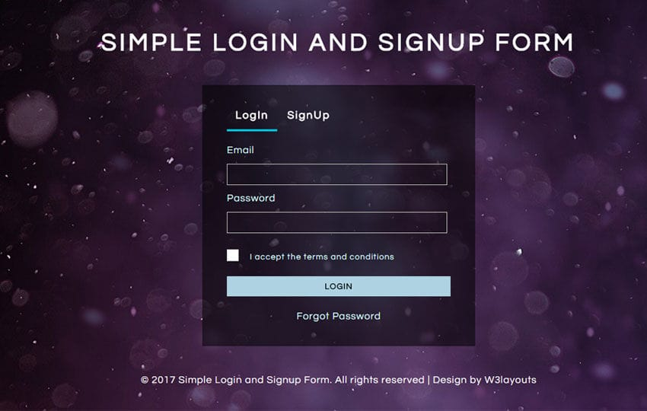
Basic App Design

Slide 17
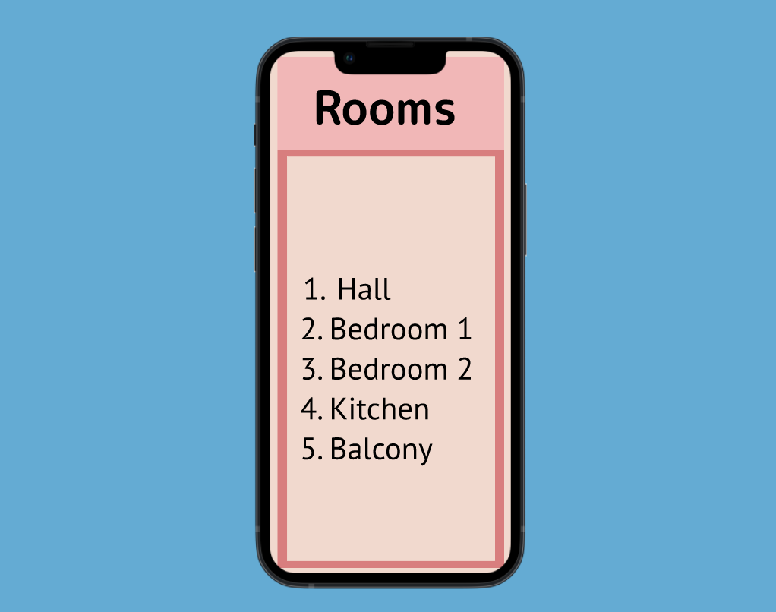
Interface for Selecting Various Rooms in the House

Slide 18
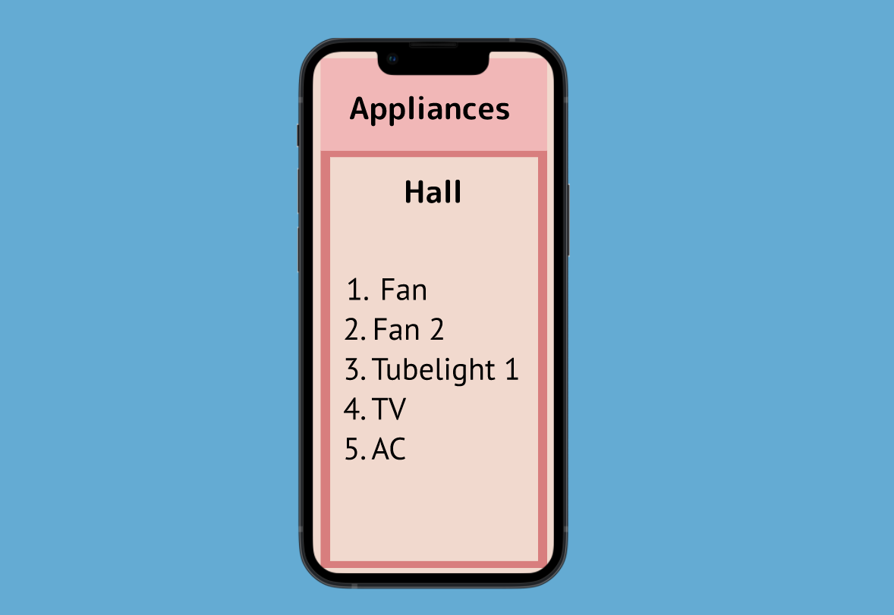
Selection of Various Appliances in the Room

Slide 19
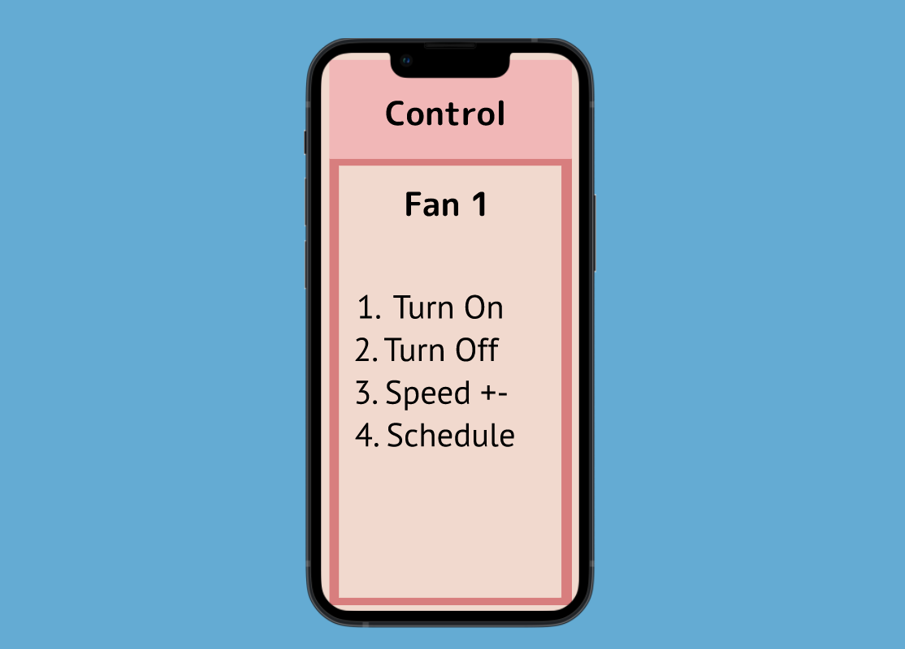
Selecting What to do with the Appliance

Slide 20
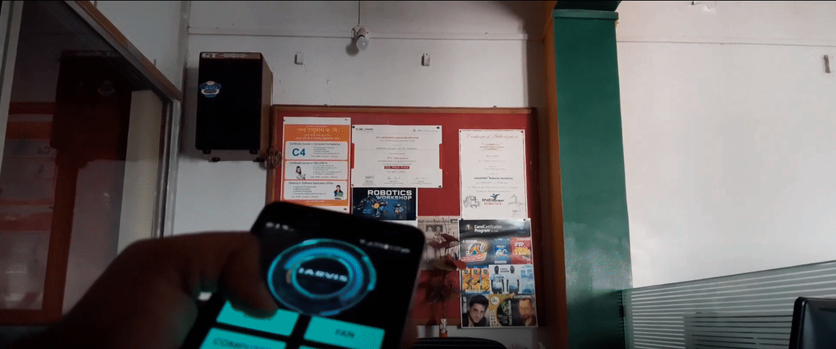
GIF of Working Shainesh Vid

Slide 21
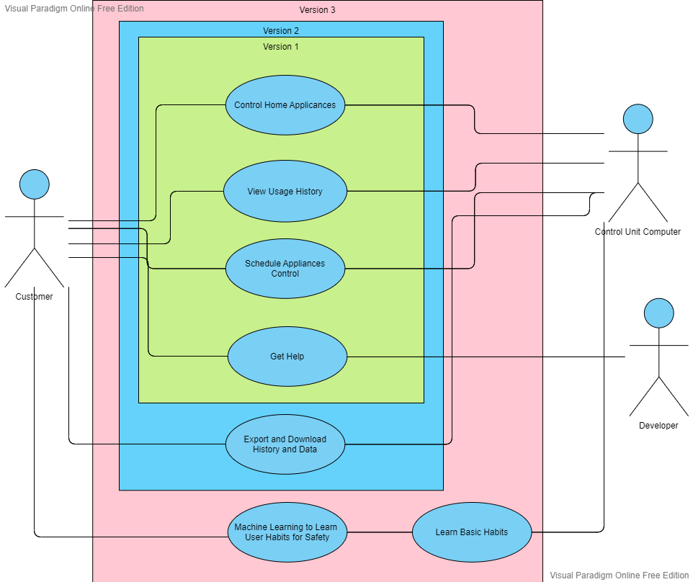
Use Case Diagram

Slide 22
Technical Stack
Raspberry PI 4
Mega WOFO R3 Atmega 2500
16 Channel Relay Board
Biometric Sensor
Ethernet Security Camera
Gas, Light, Sound and Proximity Sensors

Slide 23
Strengths
The Product will be a better, more optimal and cheaper solution to automating your home.
The Differently abled population will be able to control their appliances through voice commands, therefore making their independence more accessible to them.
The Elderly population, as well as their loved ones can rest assured that they are being monitored and safe.
The Onset of Diseases and dangerous symptoms can be deduced from a Person’s routine and health, this can help in detecting diseases on an early stage, and the App can contact the Ambulance in case of emergencies.

Slide 24
Opportunities
The Product will reduce the time taken to manage Home Applicances.
Appliances will be in safer hands as they are managed by a Protective circuits
User convenience is a priority and therefore mandates simplified and minimalistic approach in making the app.

Slide 25
Weaknesses and Threats
Potential Weaknesses include Malicious software presence on the User’s Device. Since Data is secure on the Website and its servers, which are immune to Cyber attacks, the Data is Safe, but specially designed virus could at the worst, maybe mess with the turning off and on of some Appliances.
User Data, Diagnostics and Central control however will be unharmed at all times.

Slide 26
Existing Alternatives
Companies like Schnider Electric and Viki Knows provide solutions for Home Automation but their prices range from 50k to 4 Lacs, with limited Control over the applicances.

Slide 27
Key Metrics
Our App will Record the data of our users anonymously, and we will know how many people install and use our product by the downloads and usage history of the app, that needs to be used along with the product.
Number of Sales of the Product sold Per number of people reached via Marketing of the Product will give an idea about its success.

Slide 28
One Line to Attract Customers
“Make your home truly your own”

Slide 29
Unfair Advantage by our system
There are 4 Unfair Advantages that will be provided by our system.
Low Cost
Using AI to help the elderly, detect anomalies in their routine, make them feel safe.
Making life easier for the differently abled population
Saving Electricity by efficiently using Home appliances.

Slide 30
5 Year plan, just copy paste it.
We intend to assemble the product by hand for the first Year
By the Second Year, Efficiency of the Product will improve as we will cut down the Microprocessors used to only use their relevant circuitry.
By the Third Year we will have designed and implemented well Trained and Modelled AI into these Products
This AI could be installed into pre-existing Products by simple Software Updates.
By the 5th Year we intend to completely automate production and thereby increase efficiency.

Slide 31
Cost Structure, just paste the Word Doc nicely.
Production Cost: Approx 40000 Rs
Website Creation Cost: 3000 Rs.
Website Hosting Cost: 3000 Rs.
App Creation Cost: 5000 Rs.
Servicing: 2000 Rs.

Slide 32
High Level concept, and how it fits in the grand scheme of things.
The Human Society has always tried to evolve their place of living, and the ‘home’ has undergone various technological advancements in the past.
We Hope that our Project will go down as playing the Key role in that technological advancement of the 21st Century, as It is only a matter of time before we start making full use of technology available to use for our convenience at home.
In the Grand Scheme of Things, Making Homes smart will be a key turning point, as after such advancement, The differently abled and the elderly population can find independence and Assistance much more easily.
Any Abnormal Activity can be recorded for the user’s convenience, and this will also help detect anomalies in routine, behavior, that may pertain to the onset of diseases.

Slide 33
Channels of Propagation
The primary means of marketing and propagation in the first years will be word of mouth, Instagram and other Social Media Pages
In the Later phases of the project, ads for the Product can be placed via Google Adsense.
Upon Full scale Deployment, Main Stream ads and Videos can be made.

Slide 34
Revenue Streams
Primary Revenue will be through the main purchase of the Product
If a control unit, or a switch board stops working, the replacement parts will cost extra as an Accessory to the Consumer
Smart Ads can be incorporated in the app with Google Adsense

Slide 35
“The advance of technology is based on making it fit in so that you don't really even notice it, so it's part of everyday life.” Bill Gates, Co-founder of Microsoft.

Slide 36
SIMPLE
BUSINESS PLAN
Here is where your presentation begins

Slide 37
MISSION STATEMENT
Here you could describe the business’s mission. A clear message is a good way to reach your audience

Slide 38
01
BUSINESS OVERVIEW
You could enter a subtitle here if you need it

Slide 39
02
MARKET & CUSTOMERS
You could enter a subtitle here if you need it

Slide 40
03
MARKETING & SALES
You could enter a subtitle here if you need it

Slide 41
OUR SERVICES
BASIC
STANDART
PLUS
Service 1 | Service 1 | Service 1
Service 2 | Service 2 | Service 2
Service 3 | Service 3 | Service 3
SHOP NOW!
SHOP NOW!
SHOP NOW!

Slide 42
04
MANAGEMENT PLAN
You could enter a subtitle here if you need it

Slide 43
05
OPERATING
PLAN
You could enter a subtitle here if you need it

Slide 44

ABOUT THE PROJECT
You can describe the project here
You can describe the project where
You can describe the project here

Slide 45

THIS IS NOW
Venus has a beautiful name and is the second planet from the Sun. It’s terribly hot, even hotter than Mercury

Slide 46

IN THE FUTURE
Neptune is the farthest planet from the Sun and the fourth-largest one by diameter in the Solar System

Slide 47

103,000
This is the total Seconds saved per year in managing Home Appliances

Slide 48

SNEAK PEEK
You can replace the image on the screen with your own work. Just right-click on the image and choose “Replace image” (Google Slides) or “Change Picture” (PowerPoint)

